Slide 1





NTT DATA Digital Experience | NTT DATA © Copyright 2022
_EVA FOR CONTACT CENTER March/2022

Slide 2
Contents
Amazon Connect

Slide 3


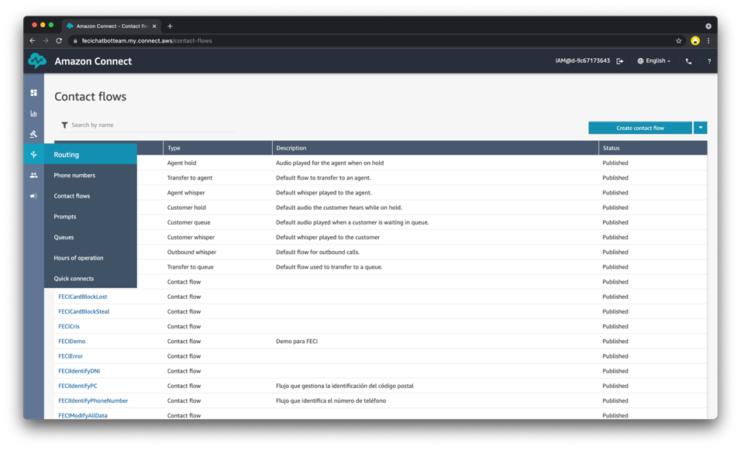
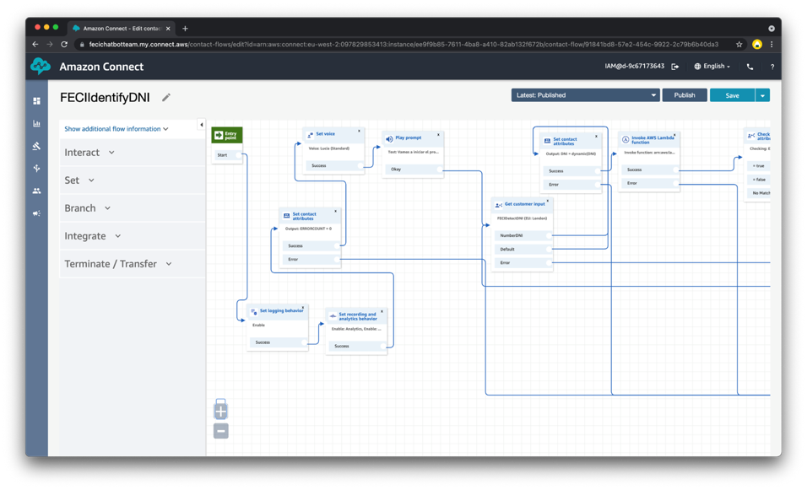
eva + Amazon connect
Amazon Connect is a cloud contact centre. It allows you to set up a contact centre in a few steps, add agents from anywhere and start interacting with your customers. You can create personalised experiences for your customers through omnichannel communications.

Slide 4







eva + Amazon connect
AWS Cloud
User
Amazon Connect
Amazon Lex
Amazon Lambda
Agent
Engagement layer
Cognitive and Logic Layer
Core Layer
The user initiates the communication by dialing a specific phone number (DID) associated with the Amazon Connect instance, starting from the left and proceeding to the right. This dialed number is designed to follow a particular Contact Flow to manage the user's interaction.
Within this process, an AWS Lambda Function is employed to fulfill the user's request. To ensure effective message processing, Amazon Lex converts the incoming speech to text (TTS).
Subsequently, the Lambda Function communicates with an endpoint located within EVA, where the virtual agent identifies the user's intent and provides a relevant response based on the conversational flow.
The response is then transmitted back to Amazon Lex, where it is transformed from text to speech (STT). A configured Output Voice is utilized to audibly relay the text to the user who initiated the call. This cycle continues until the call is either terminated or directed to a human agent.

Slide 5
eva + Amazon connect
Scenarios
Eva with Amazon Connect can be integrated with 4 different modalities:
Amazon Connect for telephony and text using Eva with an NLP (eva nlp, DF, etc..)
Amazon Connect with Lex for telephony and Eva with an NLP (eva nlp, DF, etc..) for text channels.
Amazon Connect with Lex for telephony and Eva with a Lex for text channels.
Amazon Connect with SIP tranfer to Eva.

Slide 6

eva + Amazon connect
Scenario 1. Amazon connect 100% eva + NLP - Rest of Channels: eva + NLP
telephony
Text and other channels
AWS
eva
text
answers
LEX connector
NLP connector
Transcribe - STT
LEX
3er party
Polly - TTS
NLP

Slide 7
eva + Amazon connect
Scenario 2. Amazon Connect 100% eva + LEX - Rest of Channels: eva + NLP
telephony
Text and other channels
AWS
eva
Intent + Entities
answers
LEX connector
NLP connector
Transcribe - STT
LEX
3er party
Polly - TTS
NLP

Slide 8
eva + Amazon connect
Scenario 3. Amazon connect: eva + LEX - Rest of Channels: eva + LEX
telephony
Text and other channels
AWS
Amazon Connect
eva
Intent + Entities
answers
LEX connector
NLP connector
Transcribe - STT
LEX
Polly - TTS

Slide 9
eva + Amazon connect
Scenario 3. Amazon connect telphony using SIP Transfer to eva.
telephony
Text and other channels
AWS
Amazon Connect
SIP
Eva voice gateway
eva
text
answers
LEX connector
NLP connector
Transcribe - STT
LEX
Polly - TTS

Slide 10
eva + Amazon connect
Scenarios
Scenario 1
Scenario 2
Scenario 3
Scenario 4
3rd party NLP is used
All logic in eva + NLP
Double call to NLP (Lex is always invoked)
NLP Voice Channels with LEX. Intent is passed directly to eva no double NLP call for voice.
Text Channels with 3rd party NLP
Different voice and text bots with the two engines.
Flow logic follows in EVA.
All channels use NLP from LEX
The intent is passed directly to eva in the voice channel no double NLP call for voice.
No 3rd party NLP is used at all.
All channels use NLP from LEX.
Call are transferred to EVA with SIP.
STT and TTS is managed by eva.
All text channels use eva.

Slide 11
eva + Amazon connect

Slide 12
eva + Amazon connect
Limitations
Interesting
Only allows LEX to be used as a cognitive engine. Yes or yes is invoked.
Only allows Amazon STT and TTS.
Only allows lambda as a communication mechanism.
The text from LEX is a maximum of 1000 characters.
The size of the lambda response to Amazon Connect is at most 32K.
The audio of the conversation takes time to reach S3 and only arrives after the conversation is finished.
Only allows s3 to be used to store transcripts and audios.
It is not multi-channel.
The text channel stops working properly when we apply voice features to the stream.
Multi-language is complex to manage.
Intentions and slots are shared for all bots.
Does not allow deletion of streams.
Problems of understanding with numbers and DNI with letters.
Suppression of training without explanation → change control
Not multi-channel.
The text channel stops working correctly when we apply voice features to the flow.
Multi-language is complex to manage.
Intentions and slots are shared for all bots.
Does not allow deletion of streams.
Problems of understanding with numbers and DNI with letters.
Suppression of training without explanation → change control
High understanding of LEX as NLP.
Very good option if the use case is only CC.
Different types of queues.
Transfer to other numbers within the same flow.
Easy agent transfer.
Sentiment analysis.
Modulable.
Export and Import.
LEX and Amazon Connect error notification.
Conversations stored in s3.
Data can be extracted for external analytics

Slide 13
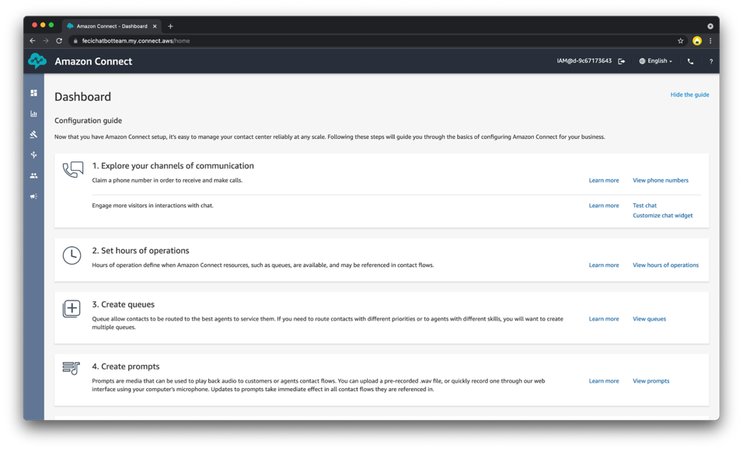
eva + Amazon connect

Slide 14
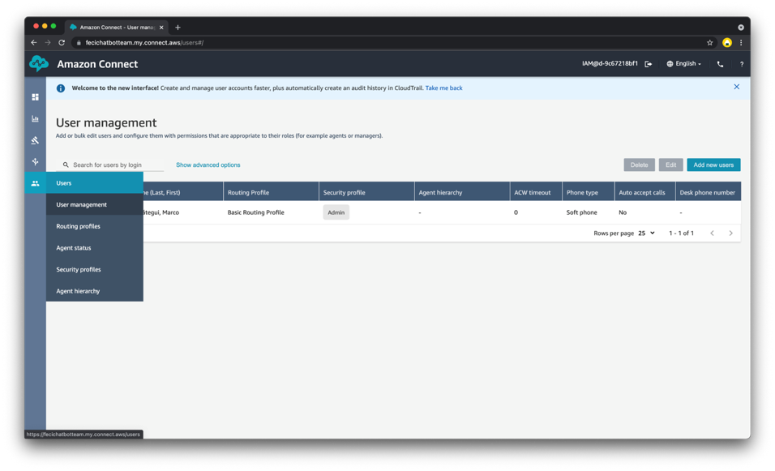
eva + Amazon connect

Slide 15
eva + Amazon connect

Slide 16
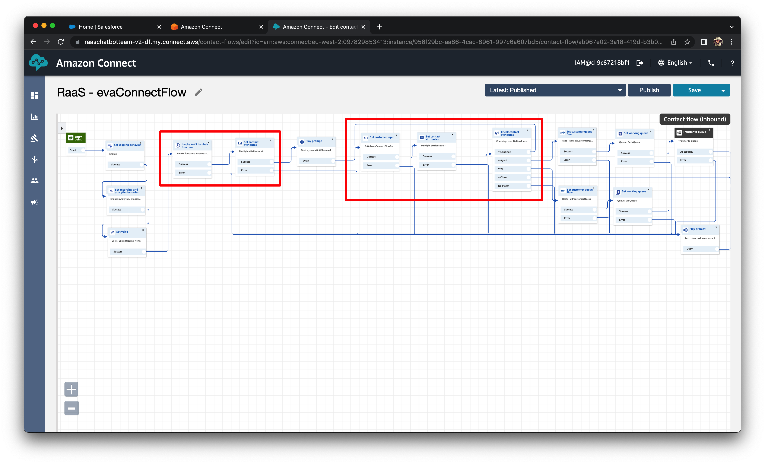
eva + Amazon connect

Slide 17

:)
thank you
_visit our website
and learn more about eva
eva.bot

